Slide 1
AppSource, Marketplace and CSP

Slide 2
AppSource

Slide 3

Microsoft AppSource
One destination for business users to discover, trial, and acquire line-of-business SaaS apps
Simplifies the discovery, trial, and acquisition of line-of-business apps
An ecosystem to help business users get started using apps faster
Helps business users do more with their existing Microsoft Apps

Slide 4
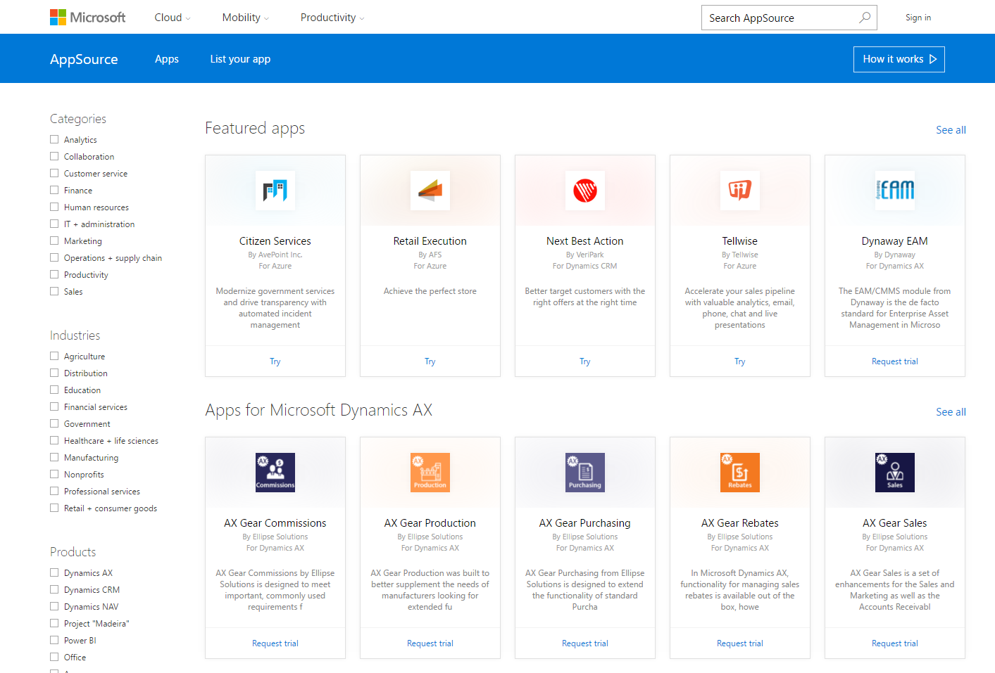
Partner opportunity
$57B+
61%
Opportunity for SaaS apps
Your LoB
app here
Independent software vendors
of technology projects funded by LoB
Line of Business users
81%
By 2019
of technology projects influenced by LoB
Global reach

Slide 5

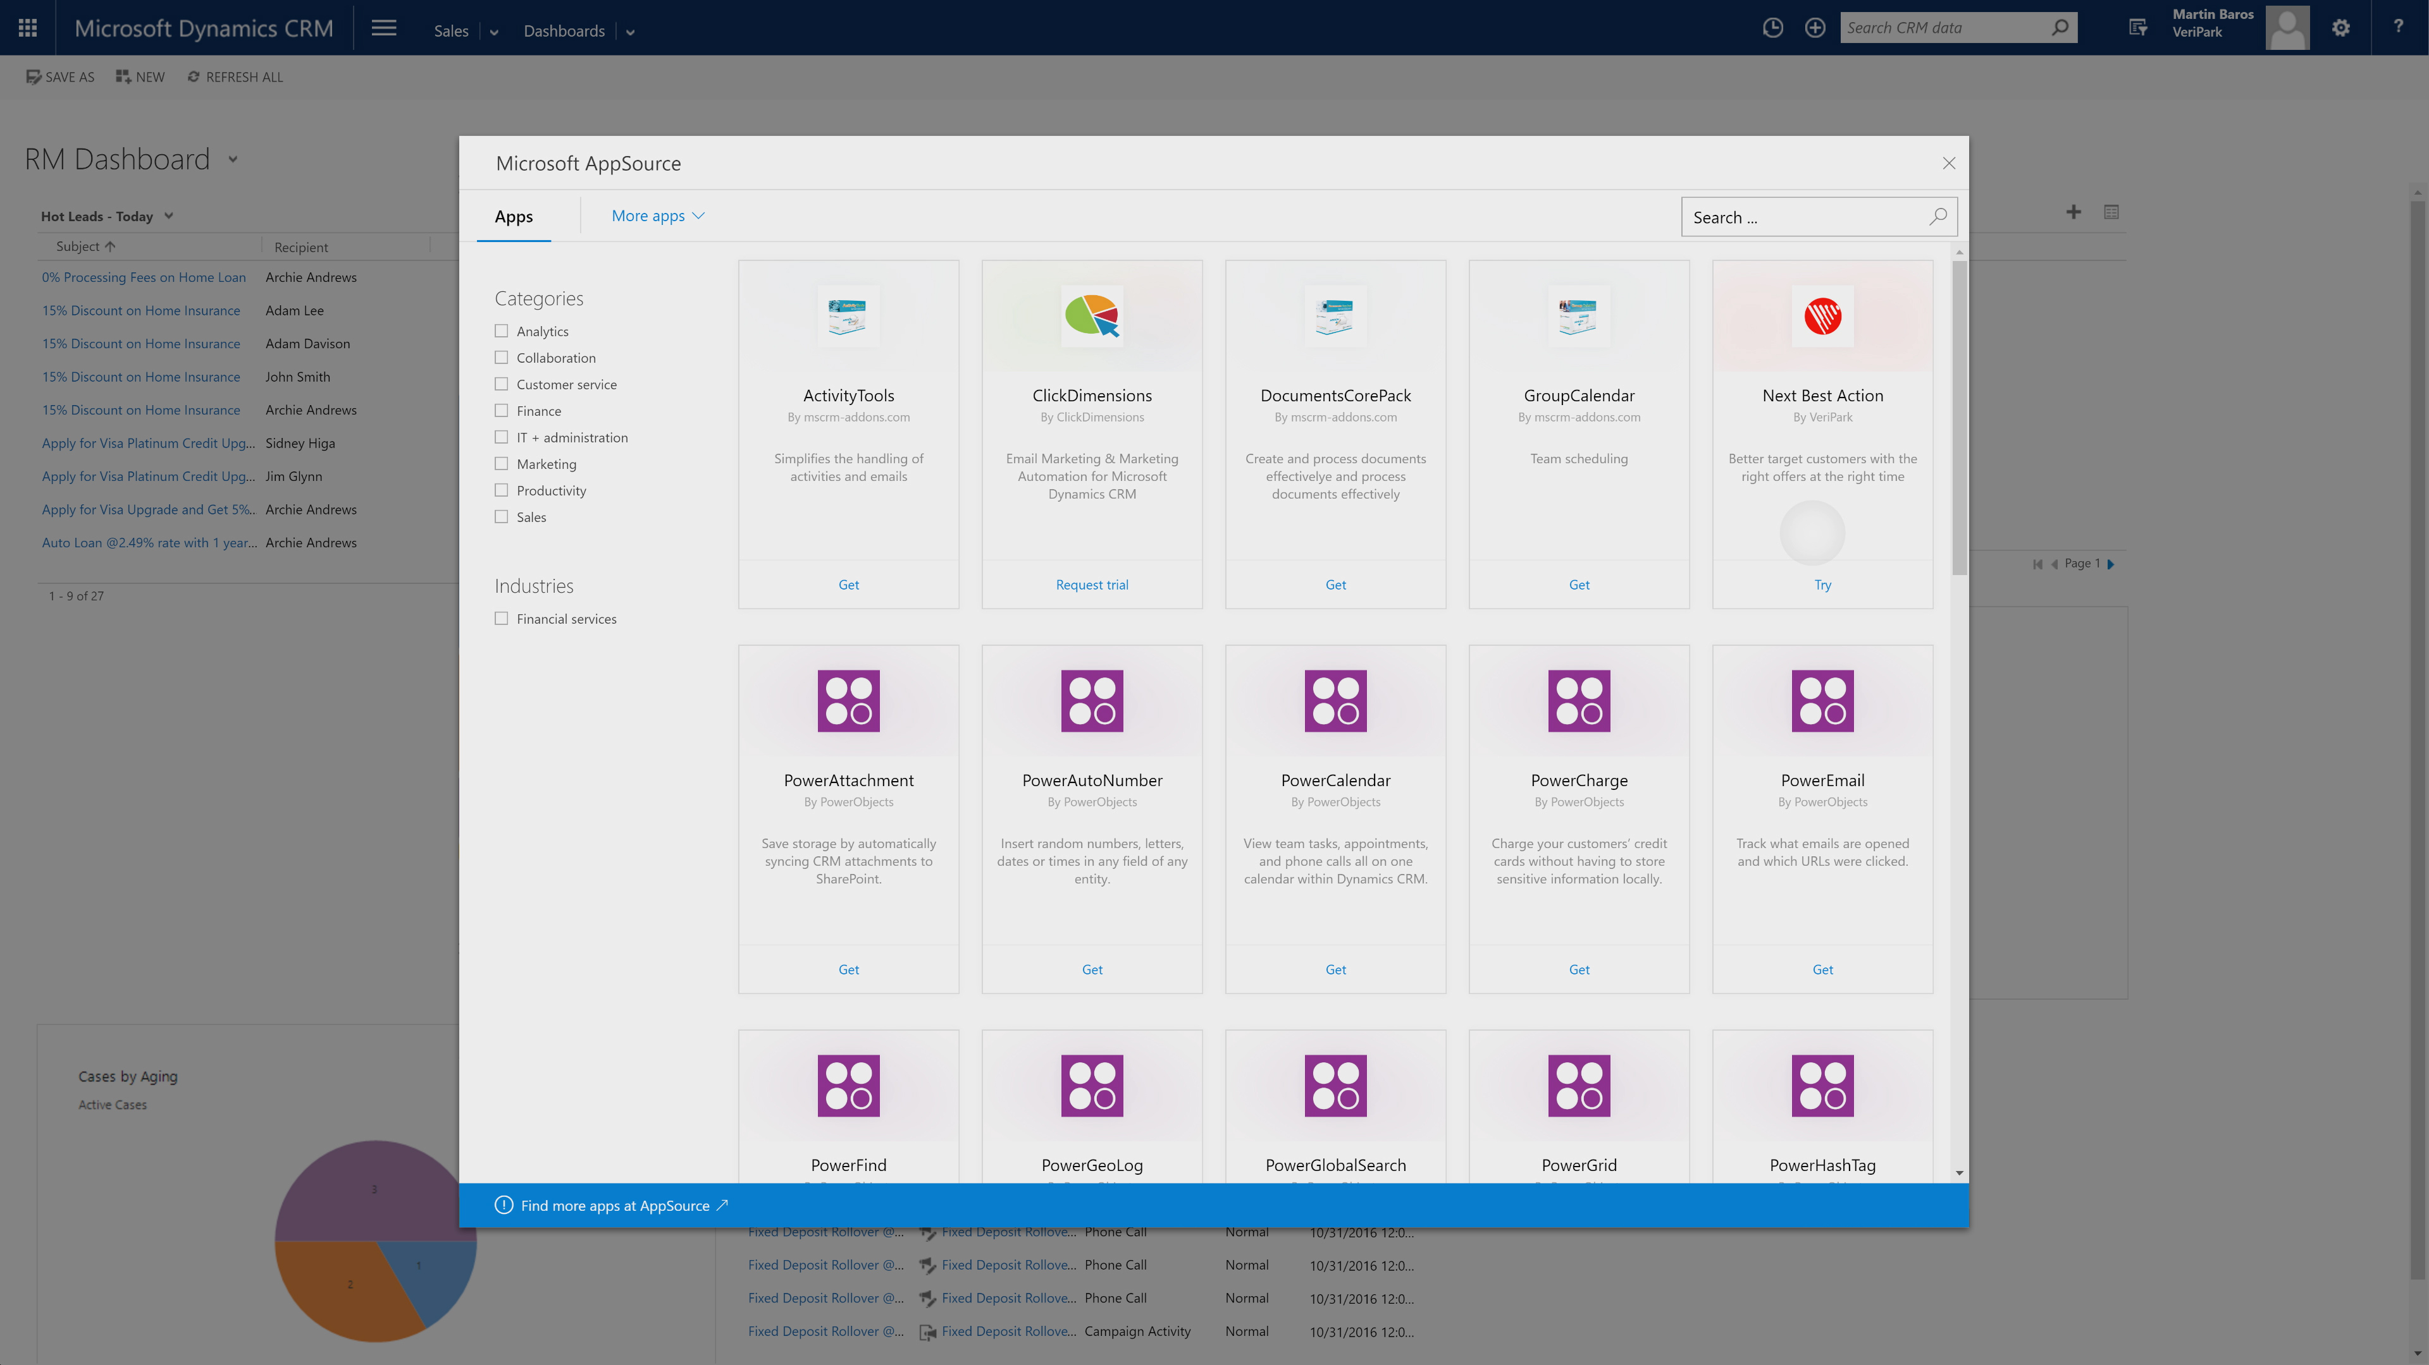
AppSource surfaced in Microsoft products

Slide 6
Marketplace

Slide 7
Agenda
What is Azure Marketplace
Overview of marketplace
Azure certify and Azure ecosystem
Azure Compute Based Solutions
Virtual Machine Images
Solution Templates
Virtual Machine Extensions
Demos
Deploying Solutions from the Portal and Command Line
Troubleshooting

Slide 8
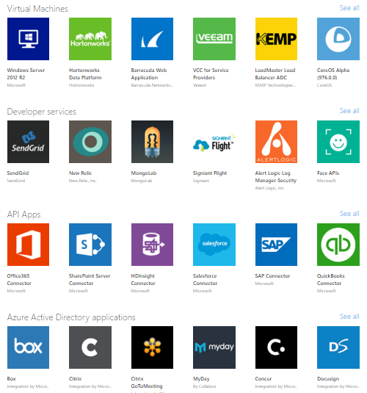
What is Azure Marketplace
Online store for Applications
Certified 3rd party applications
Linux and Windows based solutions
Easy to deploy

Slide 9
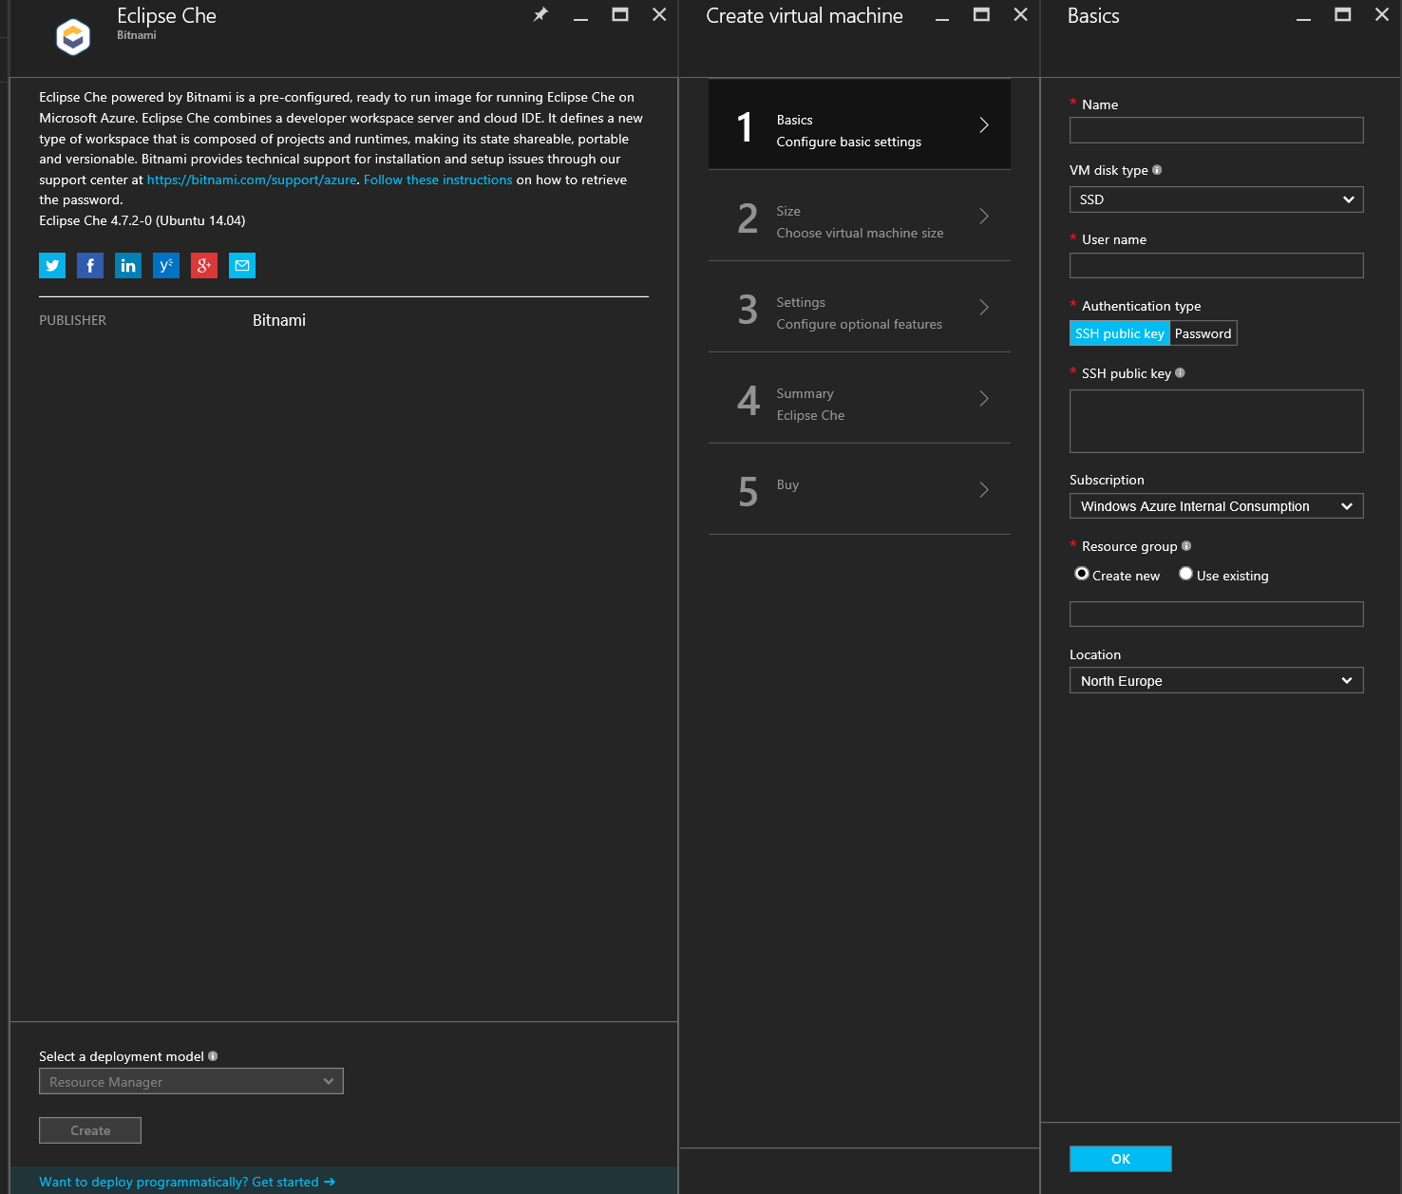
Marketplace Virtual Machine Images

Slide 10
Deploying an Azure Marketplace VM from the Portal and PowerShell

Slide 11
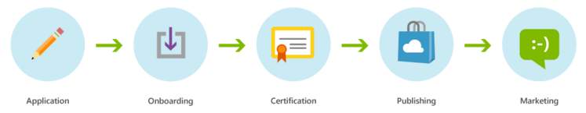
Publisher Flow
https://azure.microsoft.com/en-us/documentation/articles/marketplace-publishing-getting-started/

Slide 12
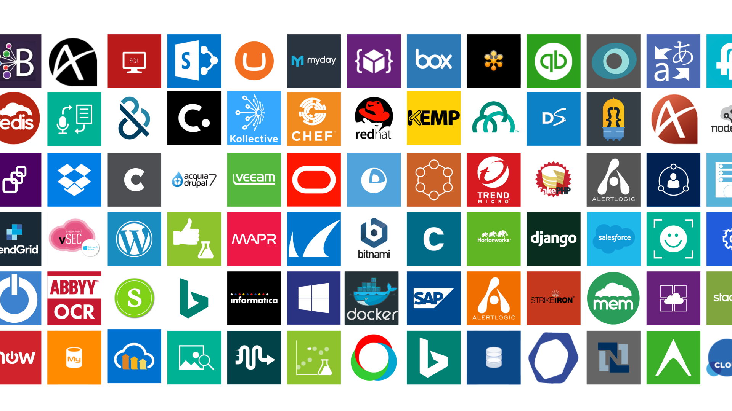
Explore popular software running on Azure!
Visit the Azure Marketplace Arcade!
MS20—located at back left of Microsoft Showcase

Slide 13
CSP

Slide 14
Questions?

Slide 16
Making Machine Learning accessible to every enterprise, data scientist, developer, information worker, consumer, and device anywhere in the world.

Slide 17
Transform data into intelligent action with Cortana Intelligence
Data sources
People
Apps
Apps
Sensors & devices
Cortana Intelligence
Automated systems
Data
Intelligence
Action

Slide 18
Cortana Intelligence Suite Transform data into intelligent action
Information Management
Big Data Stores
Machine Learning and Analytics
Intelligence
Data sources
People
Data Factory
Data Lake Store
Machine Learning
Cognitive Services
Data Catalog
SQL Data
Warehouse
Data Lake Analytics
Bot Framework
Web
Apps
HDInsight
(Hadoop and Spark)
Event Hubs
Cortana
Mobile
Apps
Stream Analytics
Bots
Dashboards & Visualizations
Sensors & devices
Power BI
Automated systems
Data
Intelligence
Action

Slide 19
Intelligent services in the cloud
Machine Learning
Algorithms
Best of Microsoft

Slide 20


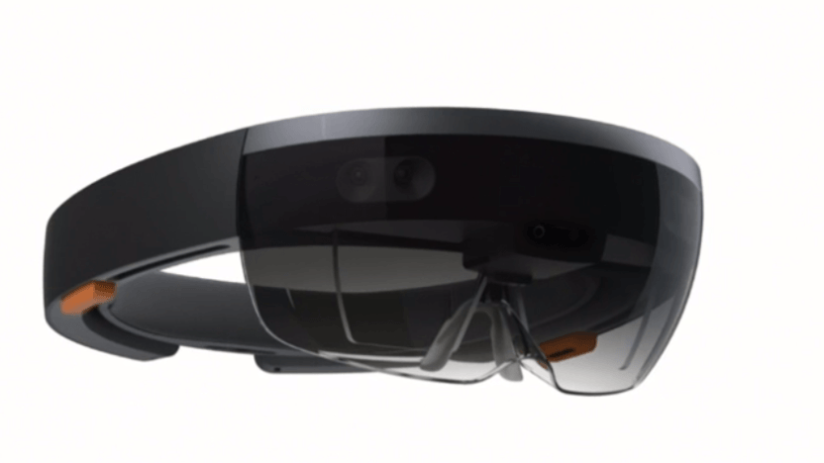
Intelligent services in the cloud
Machine Learning
Algorithms
Best of Microsoft

Slide 21
Intelligent services in the cloud
Azure Machine Learning Studio Modeling and Operationalization
Data Scientist / IT
Machine Learning
Algorithms
Best of Microsoft

Slide 22
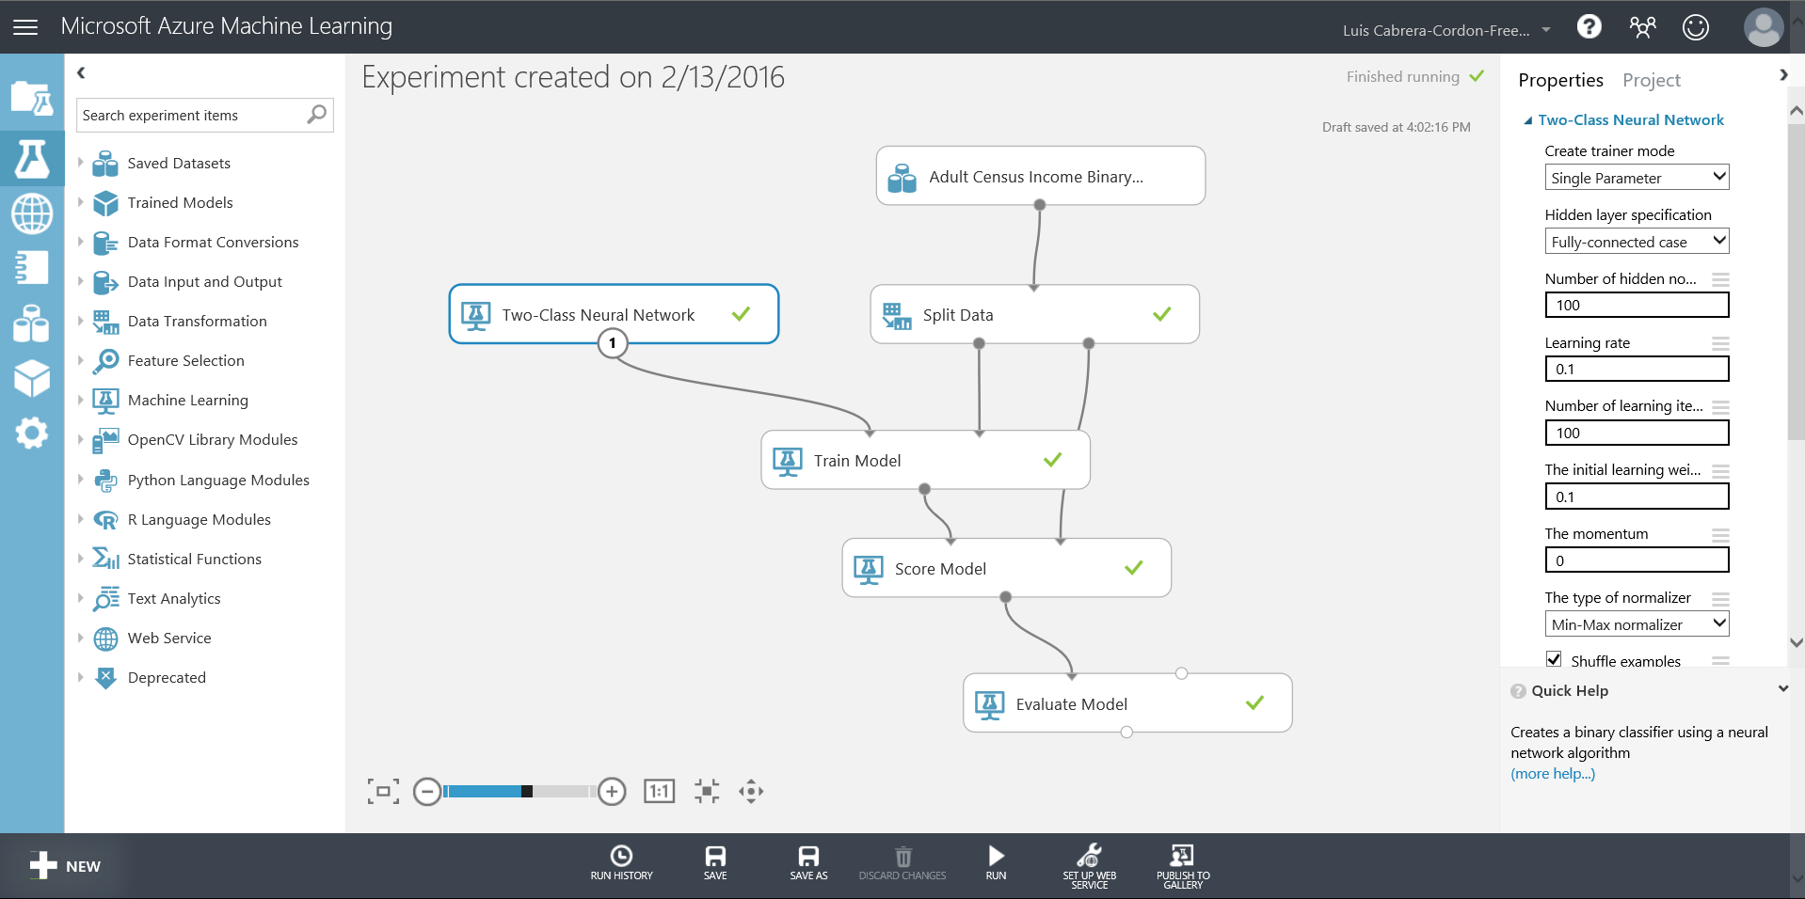
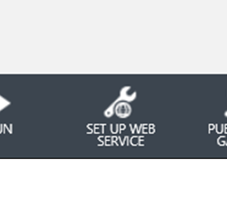
Intelligent services in the cloud

Slide 23
Intelligent services in the cloud
ML STUDIO
API
Machine Learning Studio
Model as a web service
Classic and New

Slide 24
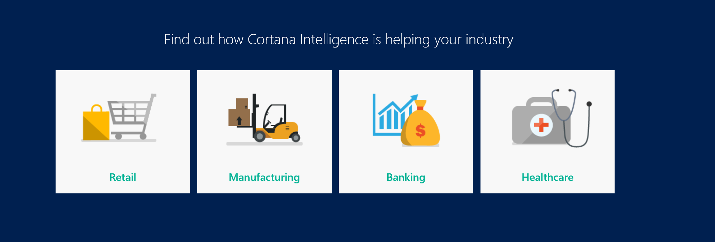
Cortana Intelligence Gallery

Slide 25
Machine Learning services in the cloud
Azure Machine Learning Studio Modeling and Operationalization
Data Scientist / IT
Machine Learning
Algorithms
Best of Microsoft

Slide 26
Machine Learning services in the cloud
Cognitive Services
Bot Framework
Developer
Azure Machine Learning Studio Modeling and Operationalization
Data Scientist / IT
Machine Learning
Algorithms
Best of Microsoft

Slide 27

Text analytics
Sentiment analysis Understand if a record has positive or negative sentiment
Key phrase extraction Extract key phrases from a piece of text, and retrieve topics
Topic detection Use clustering techniques to identify the trending topics on a large set of text records
Language detection Identify the language, 120 supported languages

Slide 28
Text analytics
Sentiment analysis English, Spanish, French, and Portuguese Understand if a record has positive or negative sentiment
Key phrase extraction English, Spanish, German, and Japanese Extract key phrases from a piece of text, and retrieve topics
Topic detection English Use clustering techniques to identify the trending topics on a large set of text records
Language detection Identify the language, 120 supported languages

Slide 29

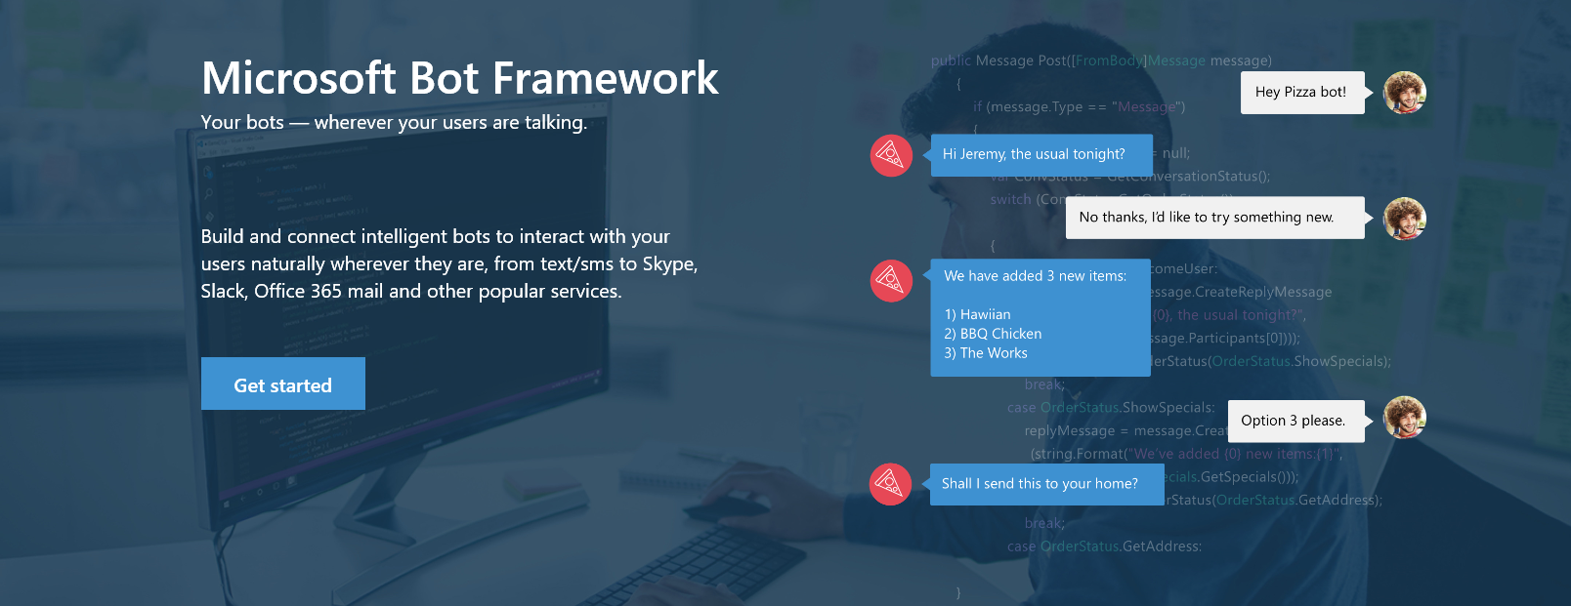

www.botframework.com

Slide 30

Bot Framework Components
Your Bot Framework Bot
Developer Portal
Bot Builder SDKs
Bot Directory
Connect your bot(s) to text/sms, Office 365 mail, Skype, Slack, and other services.
Build great dialogs within your Node.js- or C#-based bot
COMING SOON - Try, use, and add published bots to the world’s top conversation experiences
Register, connect, publish and manage your bot through the bot dashboard
Automatic card normalization across channels
Skype channel auto-configured
Embeddable web chat control
Host your bot in your app using DirectLine API
Fast, secure message routing
Diagnostic tools
Open source SDK on Github
From simple built-in prompts and command dialogs to simple to use yet sophisticated ‘FormFlow’ dialogs
Support for rich attachments (image, card, video, doc etc); support for calling Skyoe
Online/offline emulator
Add smarts with Cognitive Services
Public directory of bots registered and approved with Bot Framework
Users can try your bot from the directory via the web chat control
Users can discover and add your bot to the channels on which it is configured

Slide 31
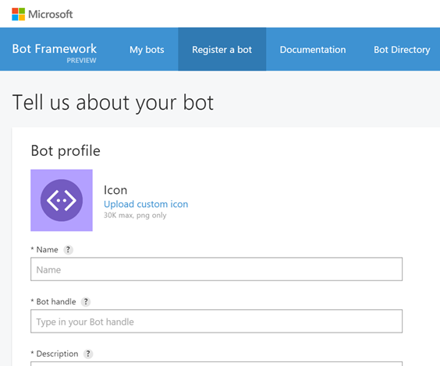
Register your bot project with Bot Developer Portal
The Bot Developer Portal allows you to register, customize and deploy a bot.

Slide 32
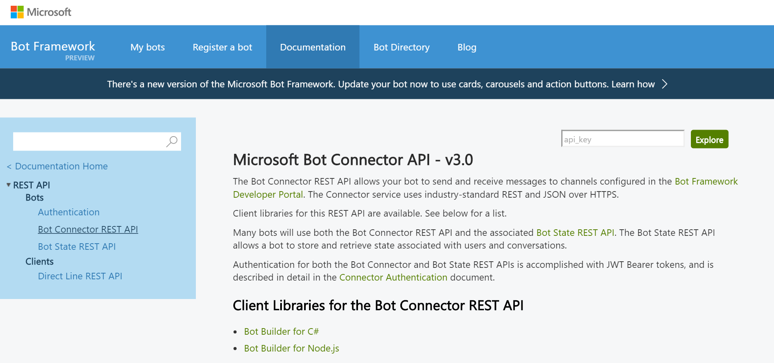
Bot Builder SDK
.NET framework with C# or Node.js
REST and REST State APIs
Manages the conversation state
Bot
Logic
Bot Builder SDK
Web
Service
LUIS

Slide 33
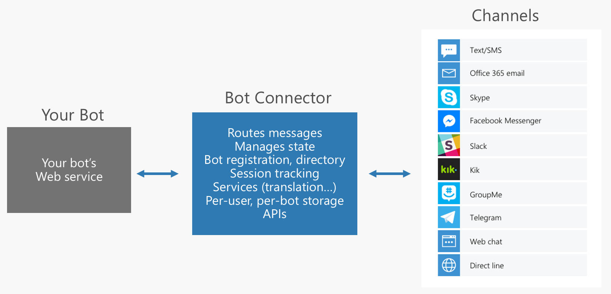
Supported Channels

Slide 34
Getting Started with Azure Bot Demo https://github.com/Microsoft/BotBuilder

Slide 35
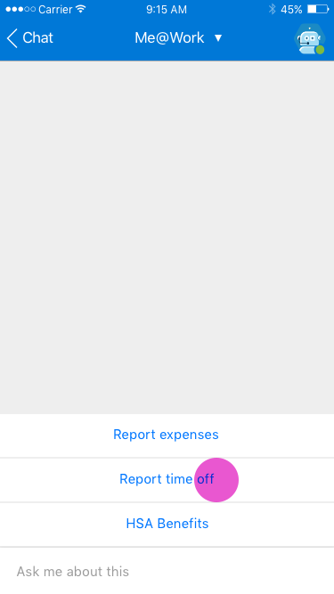
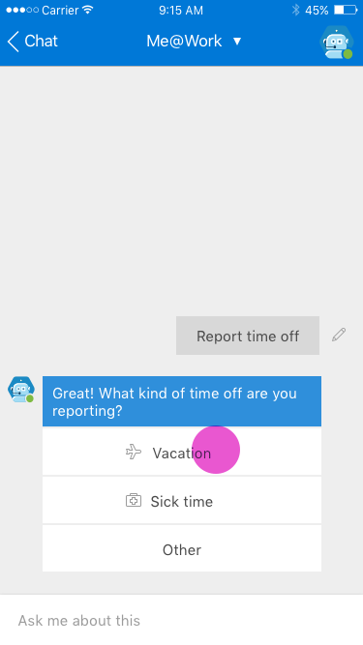
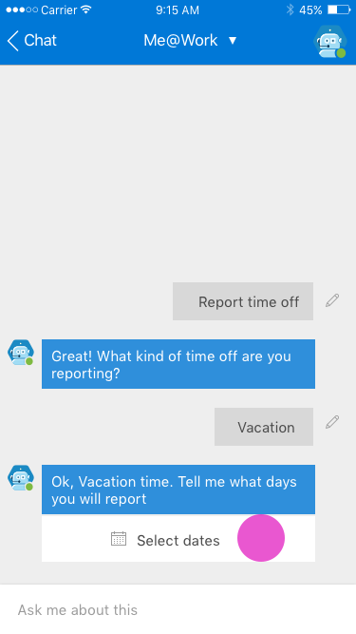
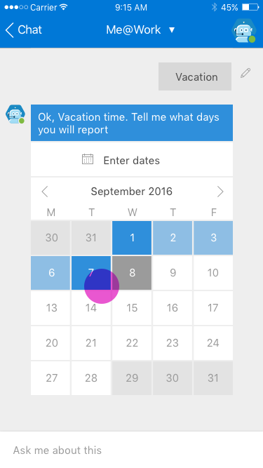
My Org Bot – Vacation Reporting

Slide 36
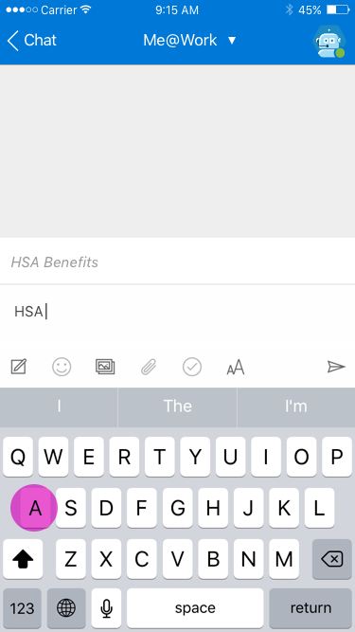
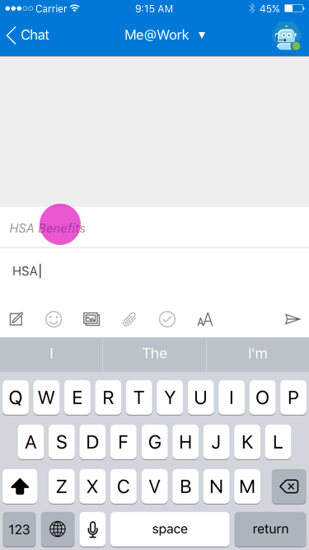
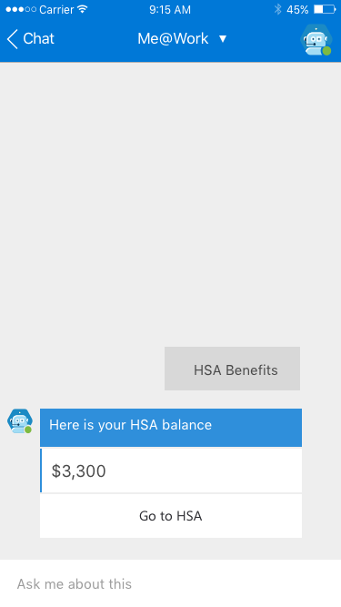
My Org Bot – HSA Account Balance

Slide 37
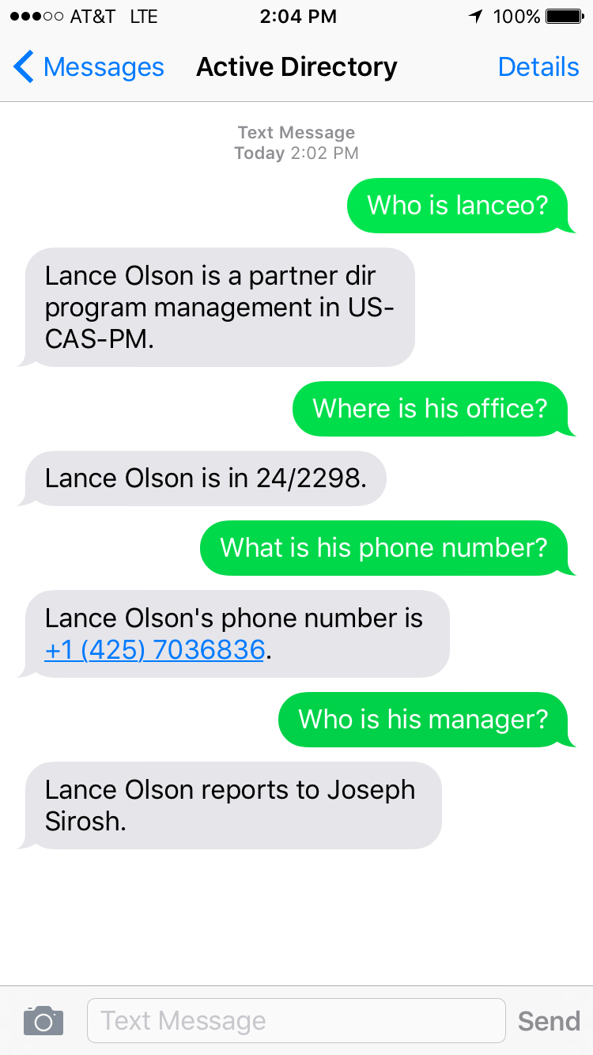
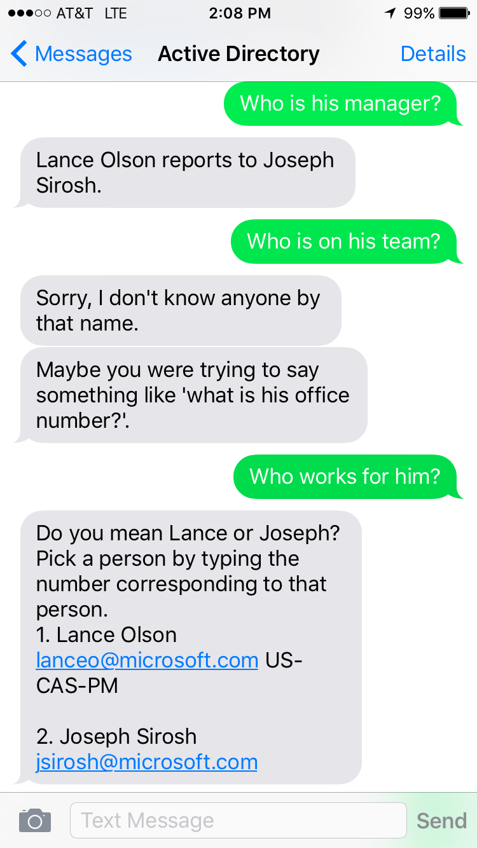
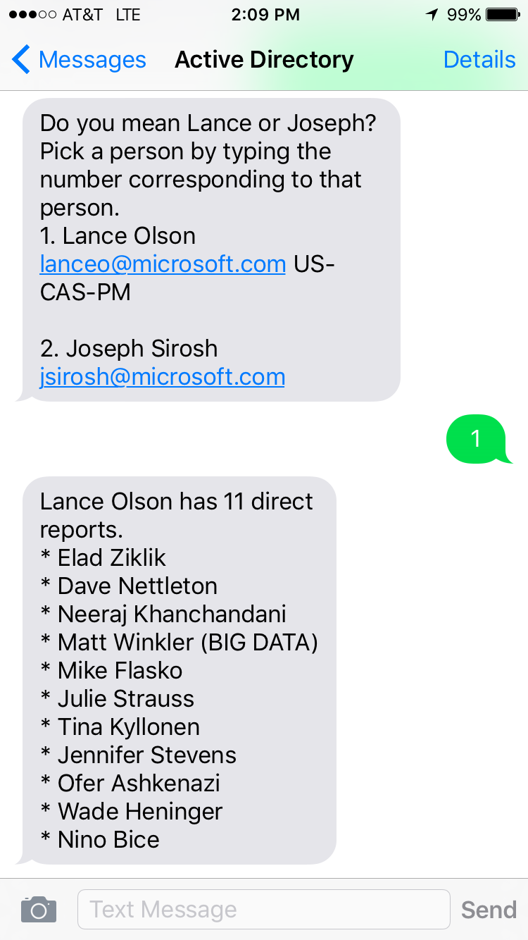
MS Internal AD Bot
Text: 206-488-1855

